Slide 1
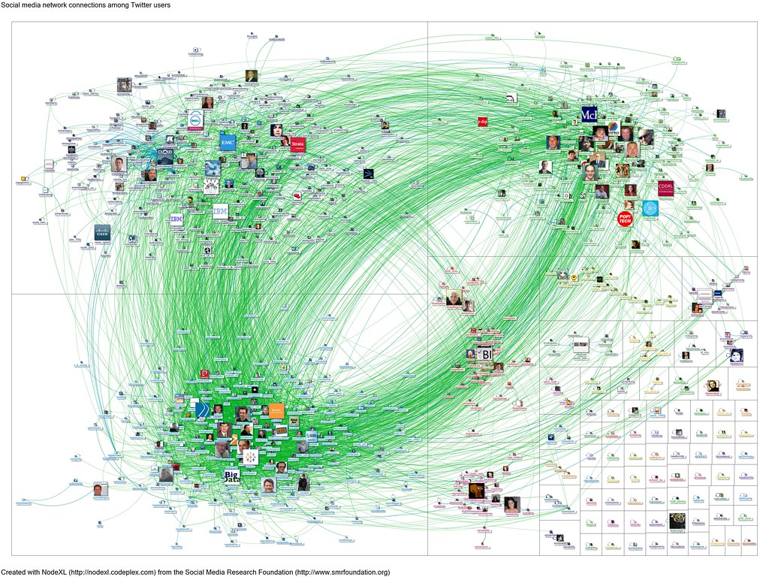
Web Document Classification using KNN
2021-CS-32 Saleem Malik
2021-CS-39 Mustafa Riaz

Slide 2
Agenda
Overview
Objective
Background
Methodology
Implementation
Evaluation
Conclusion

Slide 3

Overview
This project provides hands-on experience with graph theory and machine learning, focusing on data representation, algorithm implementation, and analytical thinking within the context of document classification.

Slide 4


Objective:
Develop a system to classify documents into predefined topics by:
Identifying common subgraphs.
Representing each document as a directed graph
Applying the K-Nearest Neighbors (KNN) algorithm based on graph similarity measures.

Slide 5
Background
The project builds on foundational research on graph-based document classification and the use of maximal common subgraphs (MCS) for graph comparison. It explores a novel approach to document classification by leveraging graph structures to capture relationships between terms, aiming to improve accuracy over traditional vector-based models.

Slide 6
Methodology
The methodology involves several key stages:
Data collection
Preprocessing
Graph construction
KNN implementation.

Slide 7
Data Collection
Collect or create 15 pages of text for each of three topics, with each page containing approximately 300 words.
Divide the dataset into a training set (12 pages per topic) and a test set (3 pages per topic)

Slide 8
Preprocessing
Text undergoes standard preprocessing steps, including stopword removal, stemming, tokenization, and removal of non-alphabetic characters, numbers, special characters, commas, full stops, and emojis.

Slide 9
Graph Construction
Documents are transformed into graph representations using the NetworkX library.
Preprocessed data is split into training and test sets for model development and evaluation.

Slide 10
Training Data Using KNN Algorithm
Identification of Maximum Common Subgraph.
Calculation of distance matrix.
Implementation of KNN algorithm using common subgraphs for classification.

Slide 11
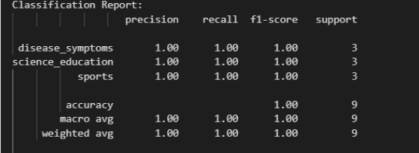
Evaluation Metrics
Accuracy
Precision
Recall
F1 score

Slide 12
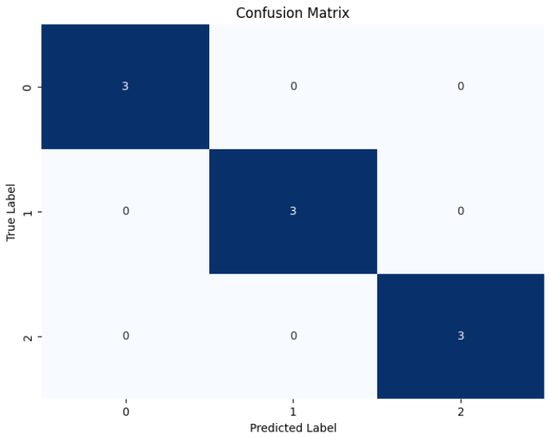
Evaluation Metrics
Confusion matrix for performance evaluation.

Slide 13
Conclusion
In this study, we implemented the K-Nearest Neighbors (KNN) algorithm for document classification using common subgraphs as features. By leveraging the structural similarities between documents, our approach achieved promising results in accurately categorizing web content.

